Slide 1
Welcome!
A critical rollout step is communicating up with your results! Prepare a simple executive summary, like this sample, to share your results with your executive sponsor and C-Level team.
Be sure to include metrics and if possible, charts or dashboards in your summary.
You should consider a weekly or monthly executive summary email that highlights these details for your executive sponsor going forward. This will help you continue to showcase your results, demonstrate return on investment, and get resources.

Slide 2

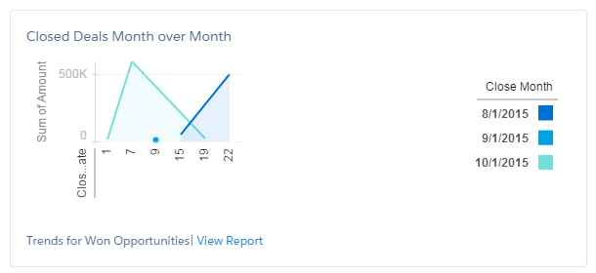
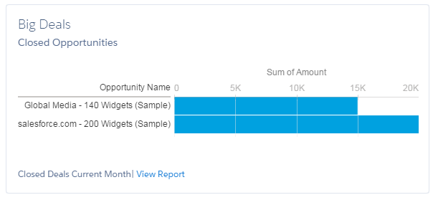
Lightning Experience Rollout Project
Executive Summary – November 2015
Project summary
Start date: 09/15/2015
Launch date: 10/15/2015
Rollout to 35 sales reps in the West Geo
Measures for success
5% increase in converted leads
5% increase in employee satisfaction
Results
8% increase in converted leads
10% increase in employee satisfaction
Anecdotes from survey
“I love the new Board and filters. It makes things so easy.”
“The new home screen is great. I want even more charts on it.”

